Slide 1


SL_EDoctor.lk Web Site Overview

Slide 2

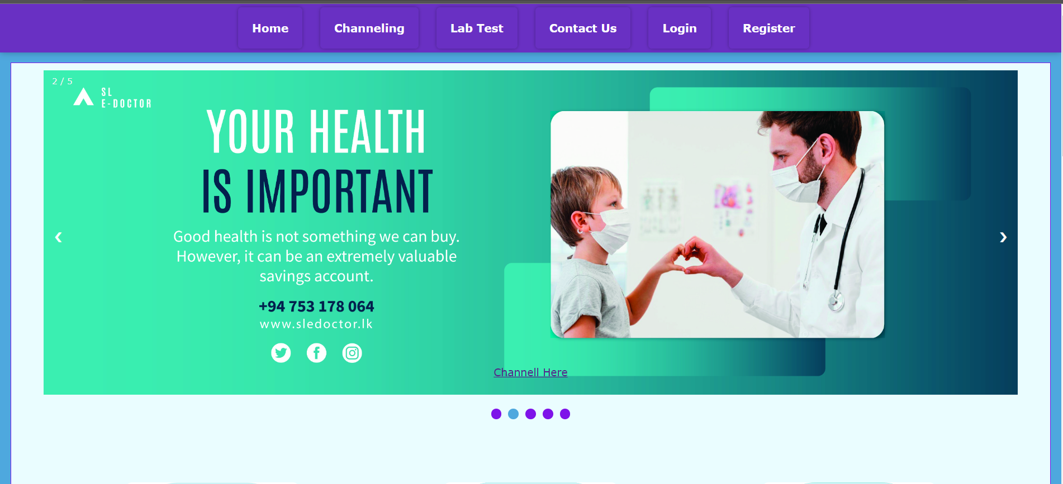
SL_EDoctor.lk

Slide 3

Introduction to the SL E-Docter
SL_Doctor.lk is a website in Sri Lanka that helps people make e-channeling appointments with doctors, dentists, and other healthcare professionals.
This platform lets users book appointments quickly and easily online, choose their preferred doctor or specialist, pick a date and time slot for their appointment, and even pay online
The website is easy to use and has a lot of information about healthcare providers, making it a great tool for anyone who needs medical attention in Sri Lanka.

Slide 4
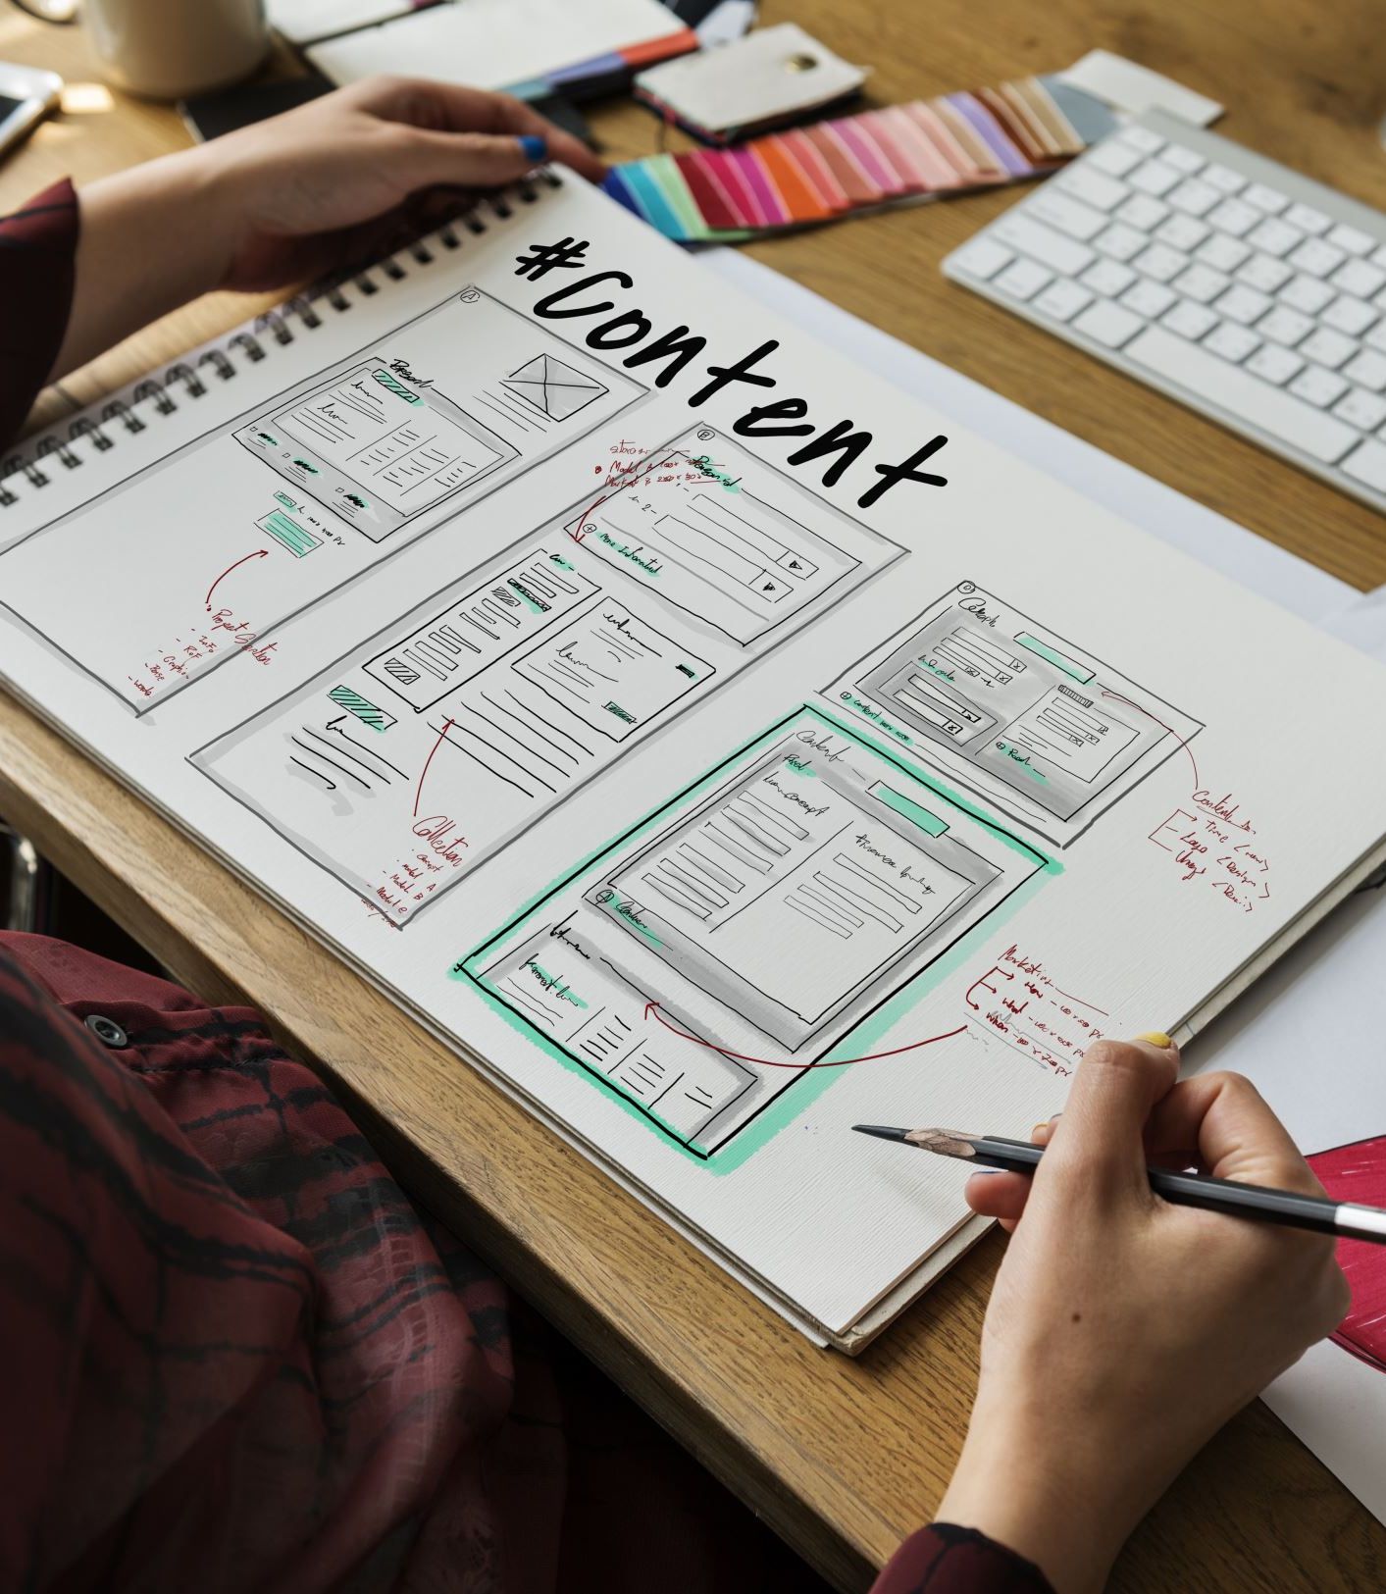
High-Level System Diagram

Slide 5
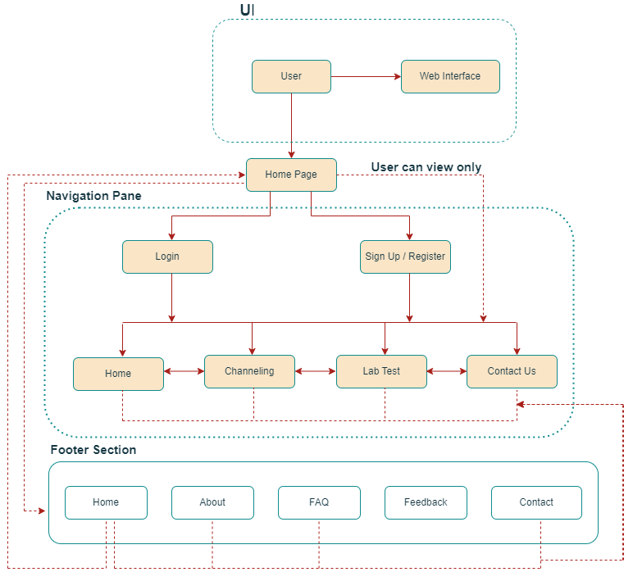
High-Level System Diagram

Slide 6

Users and Main Functionalities

Slide 7


Home

Slide 8
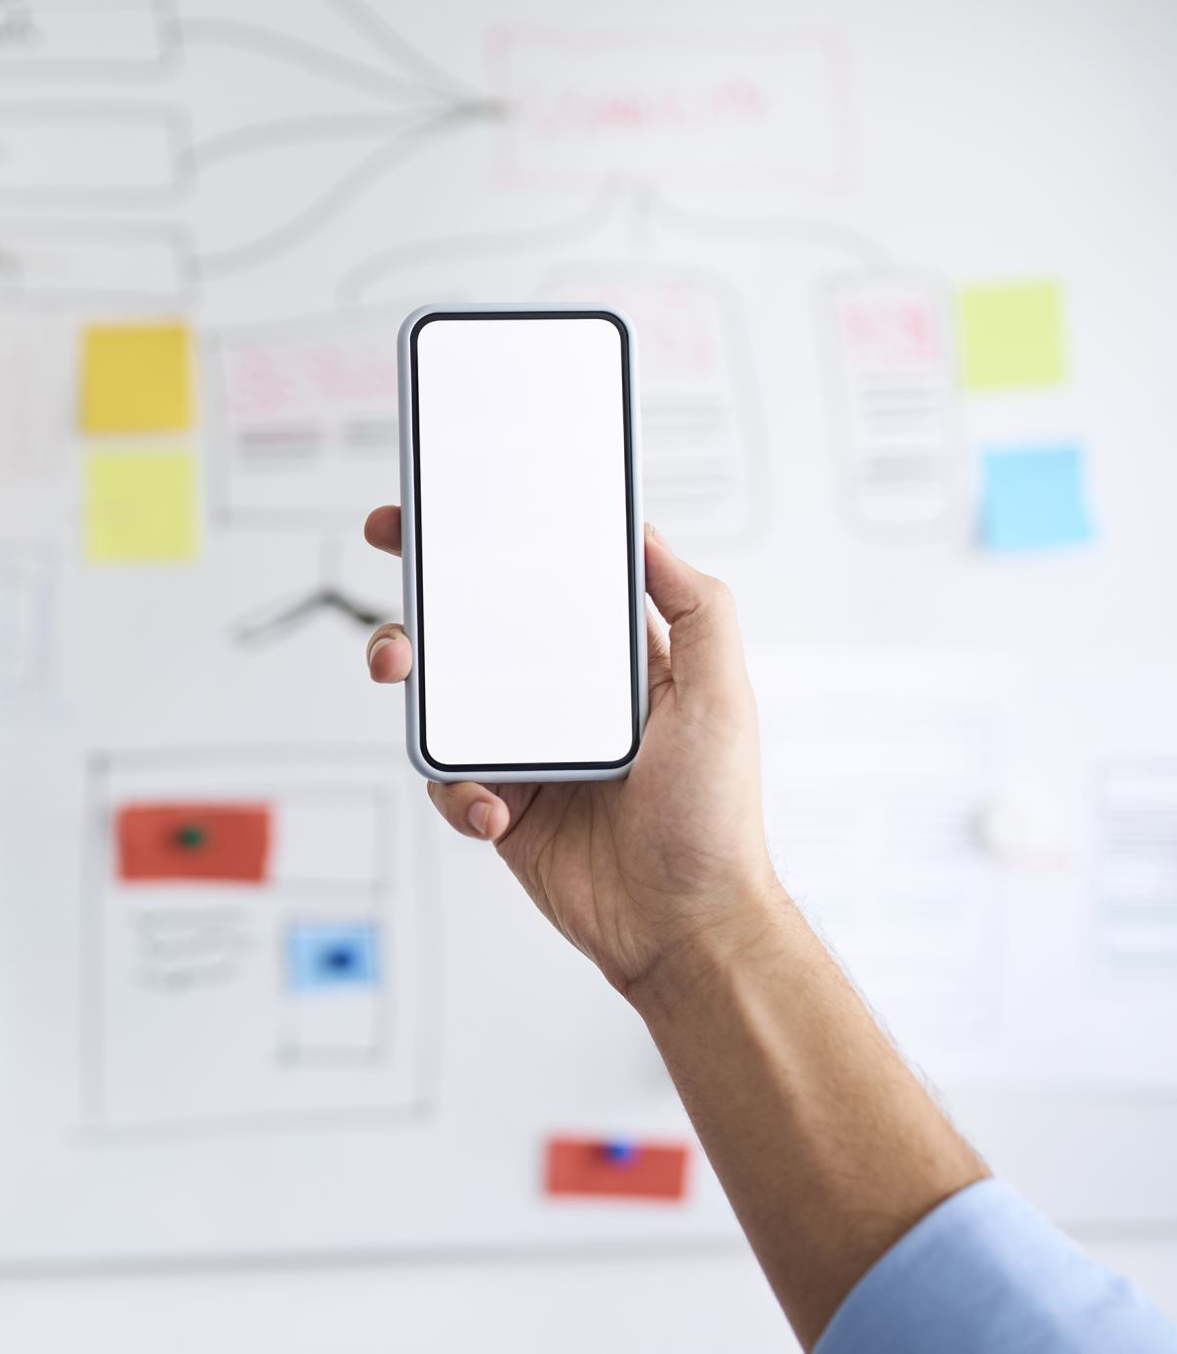
Functionalities
The Home page serves as the main landing page of the website. It typically provides an overview of the website's content, features, and services.
Users can navigate to different sections (home, channeling, lab test, contact us, login, register) of the website from the home page.
And the footer of the website provides important links (home, about, FAQ, feedback, contact), contact information (email address, phone number), and subscription options to enhance the user experience and facilitate communication with the website or its administrators.

Slide 9

Channeling

Slide 10

Functionalities
Users of the channeling function can book or set up appointments for medical appointments, and other appointments
Users can select the preferred date, time and search for a doctor and select a doctor and then they can pay the bill

Slide 11

Lab Test

Slide 12
Functionalities
The lab web page serves to display and gather information regarding lab facilities
The design is specifically finished to highlight the services of the laboratory
In order to request a lab test a patient must enter the relevant data to a form and submit it

Slide 13

Contact Us

Slide 14
Functionalities
The Contact Us page is a way for users to get in touch with the people who run or support the website
We have provided information like email, phone number, and physical address
If you have any questions or want to give feedback or need help, you can use this page to contact us

Slide 15

About Us

Slide 16

Functionalities
Sl_Doctor.lk e-channeling, Visitors can observe the aims of our mission and purpose over the about us and we have included a variety of places that can get over service our service via e-channeling site.

Slide 17

Sign Up / Register

Slide 18
Functionalities
The Register or Sign-Up feature enables new users to create an account on the website.
Users are typically required to provide relevant personal information, such as name, email address, and password, to create their account.
After signing up on the website, users typically gain access to various features and functionalities such as find doctors, channel doctors, manage appointments, check lab reports and etc.

Slide 19

Login

Slide 20
Functionalities
The Login functionality allows registered users to access their personalized accounts on the website
Users typically enter their username or email and password to log in
After successful login, the user is usually redirected to the home page of the website

Slide 21

FAQ

Slide 22

Functionalities
This page contains frequently asked questions and their corresponding answers, providing users with quick access to relevant information
This page is designed to address frequently encountered concerns and provide helpful information
This page aims to provide clear and concise explanations about various aspects of our platform and services

Slide 23

FEEDBACK

Slide 24
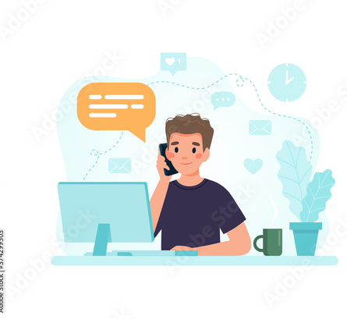
Functionalities
The Feedback page of our e-channeling system provides a platform for users to share their experiences, suggestions, and opinions about the website and its services.
On the other hand, this page allows users to provide feedback, suggestions, or report any issues they encounter with our e-channeling service.

Slide 25
Limitations of the Developed System
Limited languages :This web site supports only English language
To fix this: we should identify the target customers and then we can find the common language that they are using and then we can add a dropdown menu or radio buttons to switch between those languages
mobile version: The website does not support mobile compatibility
To fix this: we can develop a mobile version of the web site.to do so we can optimize the web site design and functionalities for mobile devices.

Slide 26
Limitations of the Developed System
Performance bottleneck : This web site does not use a database therefore when handling large number of data, there can be some difficulties
To fix this, it is recommended to select a suitable database, link it to the backend code of the website, and update the data into the database for efficient data management.
Security – There aren't currently enough security measures on the website
To fix this, we can implement HTTPS for secure communication, add Two-Factor Authentication (2FA) for user verification, perform regular security checks, enforce strong passwords, and encrypt sensitive information to enhance security and protect users' private information.

Slide 27

THANK YOU

